Slide 1

Medcurity Network Inventory
Team
< Brandon Huyck >
< Colleen Lemak >
< Artis Nateephaisan >
< Jack Nealon >
Notes:
[Brandon]

Slide 2
Project Overview
Project Purpose:
Facilitate risk assessment for medical offices (keep patient data secure)
Software and device inventory is first step
Required by HIPAA
Goal is to generate through automation
Tasks for Tool:
Scan the network
Store the data
Display to user, and allow updates
Export to CSV for accessibility
Notes:
[Brandon]
Goal: sponsor provides risk assessment for medical offices to help keep patient data secure; inventory is helpful in assessment and required by HIPAA; we develop a tool to automate the generation of this inventory.
Tasks: Scan the network; store the data; display to user and allow updates; export to excel for ease of accessibility (important to sponsor)
“Major Components”: Launch with bash, scan network, store info in db, display on ui, updatable through ui, export to excel with python

Slide 3
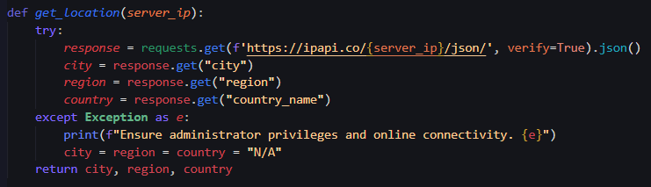
Crawler
Python3 backend
Executes Nmap and ARP scans
Collects OS name, version, device type, server location, ports & statuses, and other attributes
Launched on UI button-click, pushes to DB
Notes:
[Colleen]

Slide 4
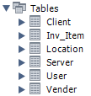
Database
MariaDB AWS Relational Database Server (RDS)
Encrypted with AES-256 algorithm
Stores devices and users
Normalized schema based on sponsor-provided list
Created Python API with data validation
Displays data to the UI through PHP
Notes:
[Brandon]
Uses a MariaDB Amazon Web Services (AWS) Relational Database Server (RDS)
Uses the industry standard AES-256 algorithm to securely encrypt the data on the server that hosts the database
Stores devices as well as users
Relations created based on list of attributes provided by sponsor
Relations are normalized, and data is validated before being inputted
Created a Python module containing a custom API for use by the Crawler and CSV Export scripts
Connects to the front-end using PHP to display the data

Slide 5
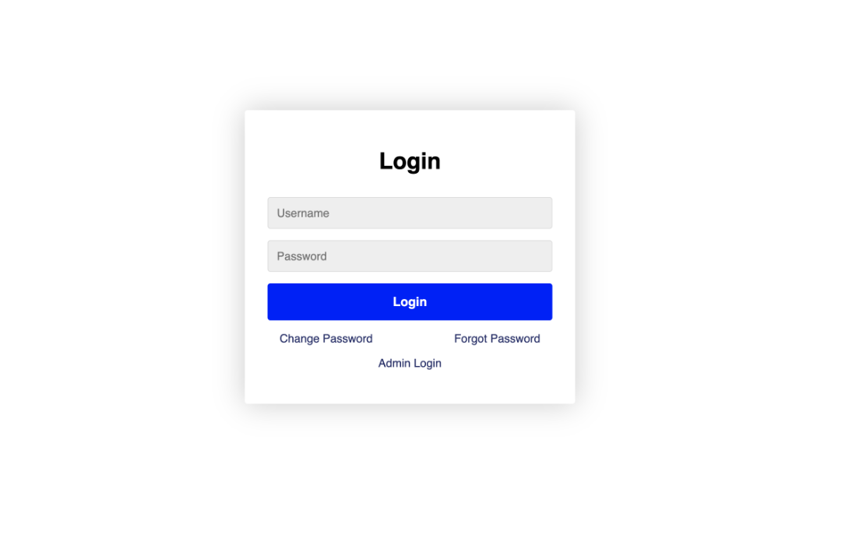
Log-In Capabilities
Login as client user or admin user
Admin can create and delete user accounts
Users able to change passwords to uphold good security practices
User passwords are encrypted using bcrypt, a a password-hashing algorithm
Notes:
[Artis]

Slide 6
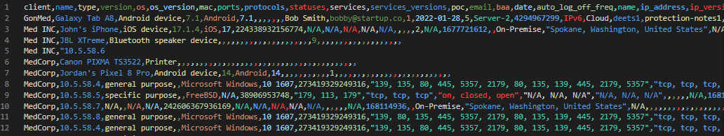
Additional Work Accomplished
Export Script (to CSV)
Testing
System Evaluation
User and Admin Documentation
README.md → For Developers and Admins
INSTRUCTIONS.md → For Users and Non-Technical Minds
Notes:
[Jack]

Slide 7
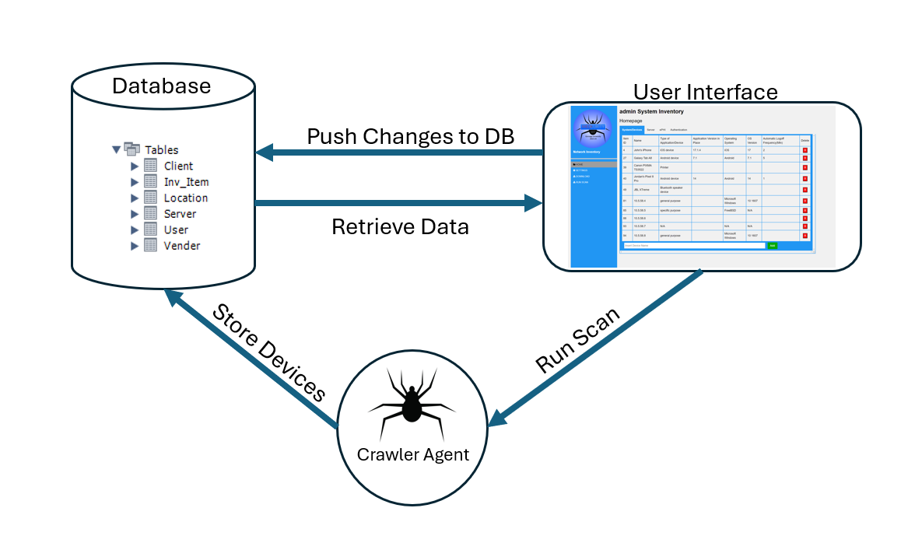
System Architecture

Slide 8
Demo
Notes:
[Jack->Artis->Jack]
Jack will do a majority of the UI talking on this slide

Slide 9
Work Remaining
Each client has a manager for user-account management
UI
Filtering
Editable cells
Network page
Relevant status messages and progress bars
Manually input IP range to scan
Further administrator privileges
Notes:
[Colleen]

Slide 10

Delivery, Deployment, Maintenance
Sponsor access to repo
Packaged into a zip file
Thorough documentation
Header comment blocks that contain developers’ GU emails
Notes:
[Artis]
5. Delivery, deployment, and maintenance
a. Briefly describe how you will be handing off your application to your
client/customer, how it will be deployed, and how it will be maintained and/or
what you did to ease maintenance
(Briefly describe how you will be handing off your application to your
client/customer, how it will be deployed, and how it will be maintained and/or
what you did to ease maintenance)

Slide 11



Summary
Software:
Development:
Management:
+ Network Crawler
+ Database
+ User Interface
+ Technology stack
+ Integration
+ Testing
+ Teamwork
+ Requirements
+ Communication
+ Reports
+ Presentations
+ Teamwork
Notes:
[Brandon]
Software
developed a tool that a+b+c and more that meets business need and stakeholder requirements
development
decided stack of Python, HTML, PHP, SQL from what we knew, what made sense, and what we were given (again) from business and stakeholder needs
Integration, and all the trouble that can bring trying to put pieces built separately together for the first time
not often had peer testing/feedback, but added invaluable perspective
Teamwork, helping, communicating, dividing tasks, trusting
management
business needs and stakeholders
status updates, check ins, reports, presentations etc
share what we are doing and how we are doing with it
keeping others updated and feeling the pressure that innately brings
aside from outside, also inside, eg scheduling meetings, having self imposed deadlines
Overall, great experience, glad we had it, and proud of everything we built, put forward, and accomplished.

Slide 12
Thank you
Notes:
[Jack->Artis->Jack]

